Slide 1
Finite State Machines
Lecture 2

Slide 2
Topics
Automata(Finite State Machines)
Deterministic Finite Automata (DFA)
Nondeterministic Finite Automata (NFA)
Notes:
Only one start state
Sigma accept only 1 and 0
Clear start state
Clear accept state (two line)
All input must be process
Don’t have ambiguous transition
Each state must process all alphabet

Slide 3
Automata/Finite State Machine
Automata (such as Finite State Machines) are tools for reasoning about computation
Finite State Machines or Finite automation*
Our model of computation comes down to two parts:
input and output language
Processor
Examples:
Automatic door
Coke machine (input money, output drinks + change if right coins inserted)
Credit card checker (input card number + expiry date, output yes or no)
Compiler (input program, output yes/no answer + compiled code)
Operating System (input commands, output could be anything!)

Slide 4
Finite State Machine/Automata
FSMs are a simple method for specifying a process
Have fixed and very limited amount of memory
Driven by input and halt when the input finishes
Have a current state
Driven by the input and change from current state to a new state
Produce simple output, often accept/reject

Slide 5
Finite State Machine/Automata
Design DFA for a coke vending machine that accepts
20c 50c and1.00 RM coins. If given 1.00 RM or more it delivers a coke.
States: Fed 0, 20, 40, 50, . . . 100+
Initial state: Fed 0
Transitions: e.g. fed 20, insert 20, new state is fed 40
Final state: Fed 100+

Slide 6
Transition Table
It is basically a tabular representation of the transition function that takes two arguments (a state and a symbol) and returns a value (the “next state”).
Rows correspond to states,
Columns correspond to input symbols,
Entries correspond to next states
The start state is marked with an arrow
The accept states are marked with a star (*).
 | 0 | 1
q0 | q0 | q1
* q1 | q1 | q1

Slide 7
Try This
Design DFA and state transition table for a Coke vending machine that accepts 20c , 50c and 1 MYR. The machine delivers a coke for 1 MYR. Assume the balance will be ejected for denominations above 1 MYR.
Identify the following :
1. Initial State 2.Final State 3.List of states

Slide 8
States, Transitions and Finite-State Transition System
State of a system
It is an instantaneous description of that system which gives all relevant information necessary to determine how the system can evolve from that point .
Transitions
changes of states that can occur spontaneously or in response to inputs to the states. Some examples of state transition systems are: digital systems, vending machines, etc.
Finite-state transition system.
System contains only a finite number of states and transitions.
Finite State Machines or Finite automation.
Finite-state transition systems can be modeled abstractly by a mathematical model

Slide 9
State Transition diagram
A state transition diagram or simply a transition diagram is a directed graph which can be constructed as follows:
For each state in Q there is a node.
There is a directed edge from node q to node p labeled a iff
(If there are several input symbols that cause a transition, the edge is labeled by the list of these symbols.)
There is an arrow with no source into the start state.
Accepting states are indicated by double circle.

Slide 10
Finite State Machine/Automata

Slide 11
Types of Finite Automata
Deterministic Finite Automata
Exactly one sequence of steps for each string
Non Deterministic Finite Automata
May have many sequence of strings
Accepts if any path ends in final state at end of string
More than one transition leaving a state on the same symbol.

Slide 12
Deterministic Finite Automation(DFA)
Definition: A deterministic finite automaton is a quintuple M = (Q, ∑, δ, q₀, F) where
Q is a finite set of states
∑ is an alphabet
q₀ ∈ Q is the initial state
F ⊆ Q is the set of final states
δ, the transition function maps Q x ∑ → Q

Slide 13
FSM Example
Let M₁ be the following finite automaton
M₁ = (Q, ∑, δ, q₁, F), where
Q = {q_{1,} q_{2,} q₃}
∑ = {0, 1}
q₁ is the start state
F = {q₂} Final state
δ is described as
 | 0 | 1
q₁ | q₁ | q₂
q₂ | q₂ | q₂
q₃ | q₃ | q₂
0
0,1
0
q₁
1
q₂
1
q₃

Slide 14
DFA Example(Type 1)
Four types
Strings ending with
Strings starting with
Substrings
Divisibility

Slide 15
DFA Example(Type 1) Strings ending with 100
M = (Q, ∑, δ, q₀, F)
q0-Initial State
q1- Strings ending with 1
q2-Strings ending with 10
q3-Strings ending with 100
Q – q0,q1,q2,q3
∑ ={0,1}
q0=q0
F=q3
Find the Transition Function?

Slide 16
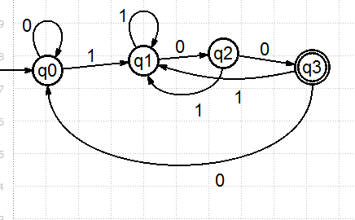
Transition Function
Transition table
 |  | 0 | 1
∑ | q0 | q0 | q1
1 | q1 | q2 | q1
10 | q2 | q3 | q1
100 | q3 | q0 | q1
DFA Diagram

Slide 17
Validate DFA Diagram
With Strings
10100 (Accepted)
10101(Rejected)

Slide 18
DFA Example(Type 2) Strings starting with aba
Q-set of states
= a,b
q0= Initial state
q1= String starts with a
q2 = String starts with ab
q3 = String starts with aba
qǿ =reject state
∑

Slide 19
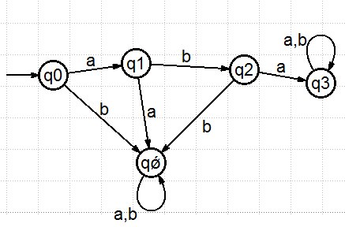
Transition table
 |  | a | b
∑ | q0 | q1 | qǿ
a | q1 | qǿ | q2
ab | q2 | q3 | qǿ
aba | q3 | q3 | q3
reject | qǿ | qǿ | qǿ

Slide 20
DFA Example(Type 3) Strings containing SubString
Construct DFA for substring bab
Q-set of states
= a,b
q0= Initial state
q1= String containing b
q2 = String containing ba
q3 = String containing bab

Slide 21
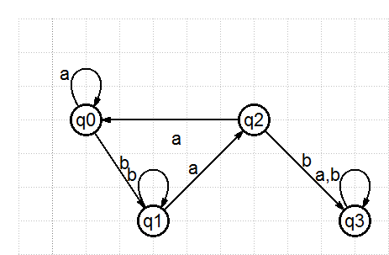
Strings containing SubString(bab)
 |  | a | b
∑ | q0 | q0 | q1
b | q1 | q2 | q1
ba | q2 | q0 | q3
bab | q3 | q3 | q3

Slide 22
DFA Example(Type 4) Divisibility
Construct DFA for Strings Divisible by 3
Q-set of states
= {0,1,2,3,4,5,6,7,8,9}
q0= 0 reminder as 0
q1= 1 reminder as 1
q2 = 2 reminder as 2

Slide 23
DFA Example(Type 4) Divisibility
Step 1:
Group Similar Numbers for Input
{0,3,6,9}
{1,4,7}
{2,5,8}

Slide 24
DFA Example(Type 4) Divisibility
Step 2:Transition Table
Eg: 00/3,03/3 ,06/3,09/3 -Remainder 0
Hence the state is q0
 |  | {0,3,6,9} | (1,4,7} | {2,5,8}
0 | q0 | q0 | q1 | q2
1 | q1 | q1 | q2 | q0
2 | q2 | q2 | q0 | q1

Slide 25
Try This
Design DFA for Strings divisible by 4.

Slide 26
Try this….
Construct DFAs for the following languages over {a, b}:
1)DFA for strings that ends with 1110
2)DFA for strings containing 'ab' as substring
3))DFA for all strings over {0, 1} that contain the
substring 1001
4) All strings over {a, b} that begins and ends
with same symbol
5)DFA for strings that starts with bba

Slide 27
Try This
DFA for strings containing ‘101' as substring
DFA for strings that starts with bba.
DFA for strings that starts with two consecutive 1’s .
DFA for strings that accepts aababb as substring
DFA for strings over {a, b} that begins and ends with same symbol

Slide 28
Try this….
Design DFA’s accepting the following languages over the alphabet {0,1}.
set of all strings ending in 00.
set of all strings with two consecutive 0’s (not necessarily at the end).
set of strings with 011 as a substring.

Slide 29
FINITE STATE MACHINES (AUTOMATA)
Deterministic Finite Automata (DFA)
Non-Deterministic Finite Automata with empty move (?-NFA)
Non-Deterministic Finite Automata (NFA)

Slide 30
Deterministic & Nondeterministic
Deterministic
Non-Deterministic
B
B
E
E
A
H
A
H
C
C
F
G
F
G
D
D
G
I
G
I
E
E
One choice
Multi choice € Backtrack

Slide 31
Deterministic & Nondeterministic
Deterministic
Non-Deterministic
B
a
a
a
A
C
A
C
a
D
From ONE state machine can go to another ONE state on one input
One choice
From ONE state machine can go to MANY states on one input
Multi choice

Slide 32
Non-determinism
Machine that does not require an input to change its state from present state
input
Machine
s0
s1

Slide 33
Non-determinism
Hence the computation cycle is now:
(Same) Read current input symbol x. Halt if end-of-input.
(NEW) Choose a new state from x and the current state. If there are no such states, halt with failure.
(Same) Move the input tape head one position to the right.
Note that step 2 is now nondeterministic, and that the machine can halt with failure before the end of the input is reached.
Acceptance only requires that there is at least one computation which succeeds.

Slide 34
Nondeterministic Finite Automata (NFA)
Definition: A non-deterministic finite automaton is a quintuple M = (Q, ∑, δ, q₀,F) where
Q is a finite set of states.
∑ is a finite set of symbols called the alphabets.
δ is the transition function where δ: Q × {∑ ∪ ε} → 2^{Q} (Here the power set of Q (2^{Q}) has been taken because in case of NDFA, from a state, transition can occur to any combination of Q states)
q₀ is the initial state from where any input is processed (q₀ ∈ Q).
F is a set of final state/states of Q (F ⊆ Q).
DFA specifies exactly one transition for each combination of state and input symbol while NFA allows zero, one or more transitions

Slide 35
NFA
L={ ends with ‘a’}
Eg:abaa
a
a,b
A
B
A,a
A,b
B,a
B,b
{Ǿ}
{A}
{B}
{A,B}
Qx ∑

Slide 36
NFA
In NFA for each state there can be zero, one, two or more transitions corresponding to each particular symbol.
If NFA gets to state with more than one transition corresponding to the input symbol, we say it “Branches”
If NFA gets to a state where there is no valid transition, then the branch dies.

Slide 37
NFA Design
Without ε Moves
With ε Moves

Slide 38
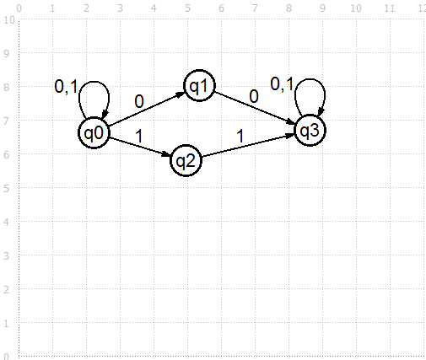
NFA without Epsilon (ε) Transitions Design
NFA for String that accepts two consecutive 0’s or 1’s.

Slide 39
Try This
NFA for String that accepts two consecutive 0’s or 1’s.

Slide 40
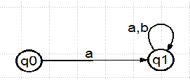
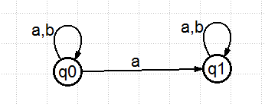
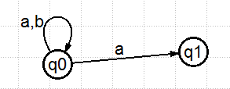
Examples for NFA without Epsilon (ε) Transitions Design
L1={starts with ‘a’}
L1={Contains ‘a’}
L1={ends with ‘a’}

Slide 41
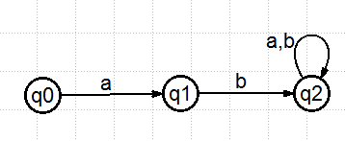
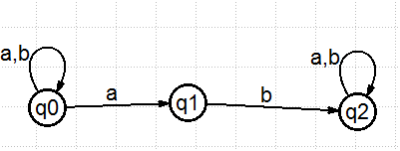
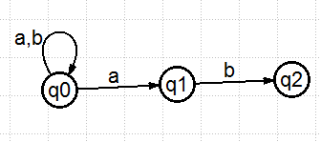
Examples for NFA without Epsilon (ε) Transitions Design
L1={starts with ‘ab’}
L1={Contains ‘ab’}
L1={ends with ‘ab’}

Slide 42
Try This
Design NFA for string starts with 0
Design NFA for string starts with 01
Design NFA for string starts with 00
Design NFA for string ends with 010
Design NFA for string contains 101
Design NFA that starts with aa and ends with ab
Design NFA that contains WW^{R}

Slide 43
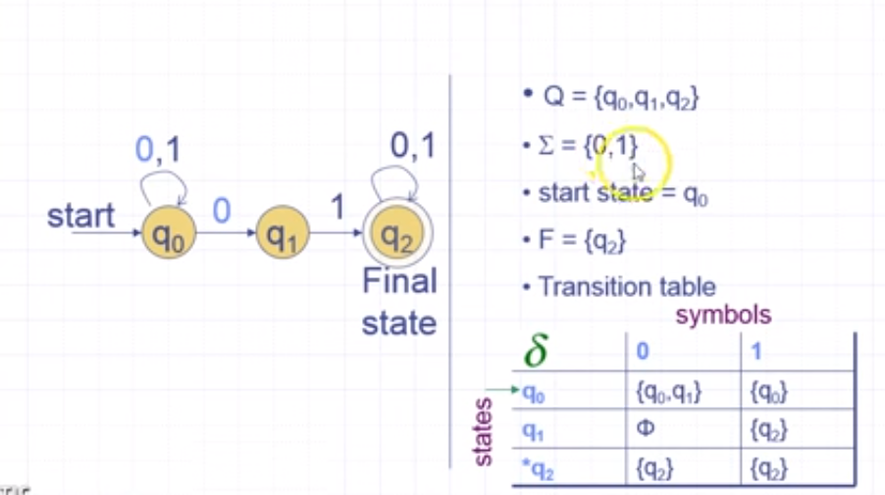
NFA Example String Containing 01

Slide 44
NFA with Epsilon (ε) Transitions Design
We allow the automation to accept the empty string ε.
This means that a transition is allowed to occur without reading in a symbol.
The resulting NFA is called ε-NFA.
It adds “programming (design) convenience” (more intuitive for use in designing FA’s)

Slide 45
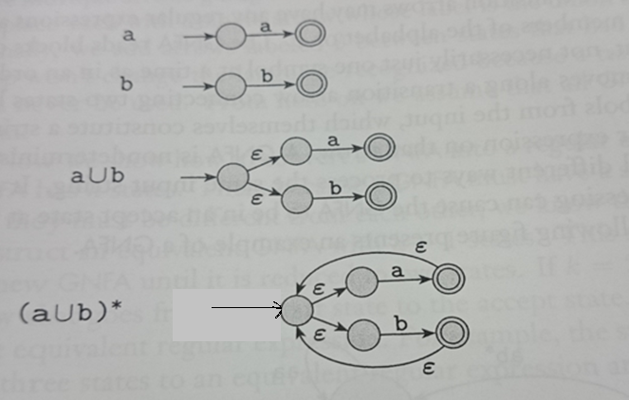
Examples for NFA with Epsilon (ε) Transitions Design

Slide 46
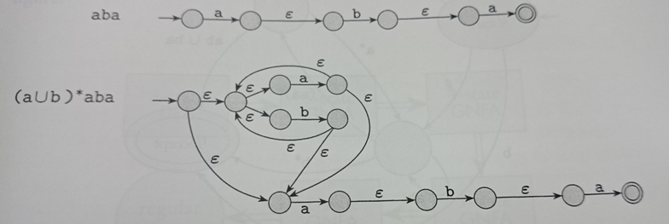
Examples for NFA with Epsilon (ε) Transitions Design

Slide 47
Try This
Construct NFA with ε moves
01
0011
(ab U aba)*
a* + (ab)*
Binary String With 00 or 11 as substring
Design NFA for aa(a υ b)* ba

